Slide 1
Teamwork
Chapter 14
McGraw-Hill/Irwin
Copyright © 2011 by the McGraw-Hill Companies, Inc. All rights reserved.

Slide 2
Learning Objectives
LO 1 Discuss how teams can contribute to an organization’s effectiveness
LO 2 Distinguish the new team environment from that of traditional work groups
LO 3 Summarize how groups become teams
LO 4 Explain why groups sometimes fail
LO 5 Describe how to build an effective team
LO 6 List methods for managing a team’s relationships with other teams
LO 7 Identify ways to manage conflict
14-<number>

Slide 3

The Contributions of Teams
Building blocks for organizational structure
Increase quality and productivity while reducing costs
Enhance speed and be powerful forces for innovation and change
14-<number>

Slide 4

The New Team Environment
Team
  A small number of people with complementary skills who are committed to a common purpose, set of performance goals, and approach for which they hold themselves
  mutually accountable.
14-<number>

Slide 5
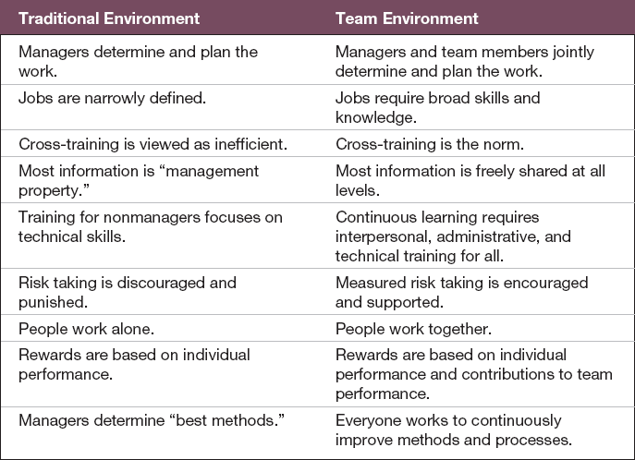
The New Team Environment
Table 14.1
14-<number>

Slide 6
Types of Teams
Work teams
  Teams that make or do things like manufacture, assemble, sell, or provide service.
Project and development teams
  Teams that work on long term projects but disband once the work is completed.
14-<number>

Slide 7

Types of Teams
Parallel teams
  Teams that operate separately from the regular work structure, and exist temporarily.
14-<number>

Slide 8
Types of Teams
Management teams
  Teams that coordinate and provide direction to the subunits under their jurisdiction and integrate work among subunits.
14-<number>

Slide 9
Types of Teams
Transnational teams
  Work groups composed of multinational members whose activities span multiple countries.
Virtual teams
  Teams that are physically dispersed and communicate electronically more than face-to-face.
14-<number>

Slide 10
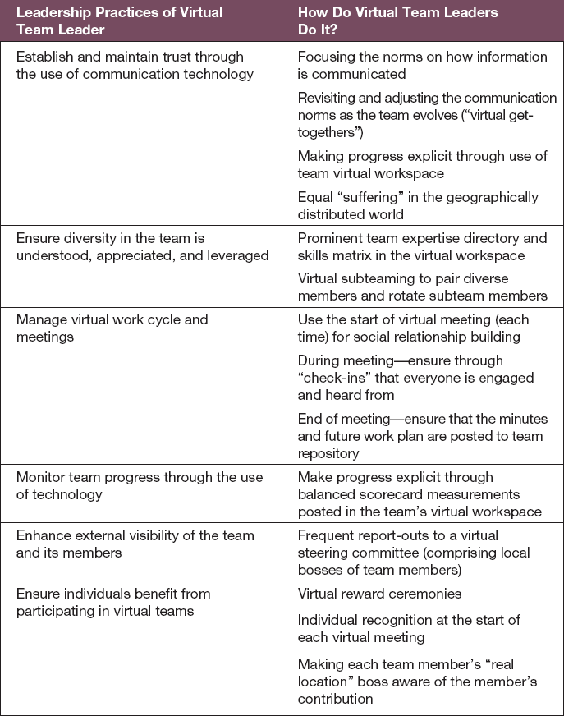
Practices of Effective Virtual
Team Leaders
Table 14.2
14-<number>

Slide 11
Self-Managed Teams
Self-managed teams
  Autonomous work groups in which workers are trained to do all or most of the jobs in a unit, have no immediate supervisor, and make decisions previously made by frontline supervisors.
14-<number>

Slide 12
Self-Managed Teams
Traditional work groups
  Groups that have no managerial responsibilities.
Quality circles
  Voluntary groups of people drawn from various production teams who make suggestions about quality.
14-<number>

Slide 13
Self-Managed Teams
Semiautonomous work groups
  Groups that make decisions about managing and carrying out major production activities but get outside support for quality control and maintenance.
Autonomous work groups
  Groups that control decisions about and execution of a complete range of tasks.
14-<number>

Slide 14
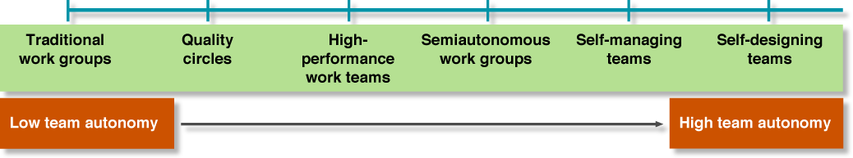
Team Autonomy Continuum
Figure 14.1
14-<number>

Slide 15

Group Activities
Forming
  group members attempt to lay the ground rules for what types of behavior are acceptable.
Storming
  hostilities and conflict arise, and people jockey for positions of power and status.
14-<number>

Slide 16
Group Activities
Norming
  group members agree on their shared goals, and norms and closer relationships develop.
Performing
  the group channels its energies into performing its tasks.
14-<number>

Slide 17
Group Activities
Groups that deteriorate move to a declining stage, and temporary groups add an adjourning or terminating stage.
Groups terminate when they complete their task or when they disband due to failure or loss of interest
14-<number>

Slide 18
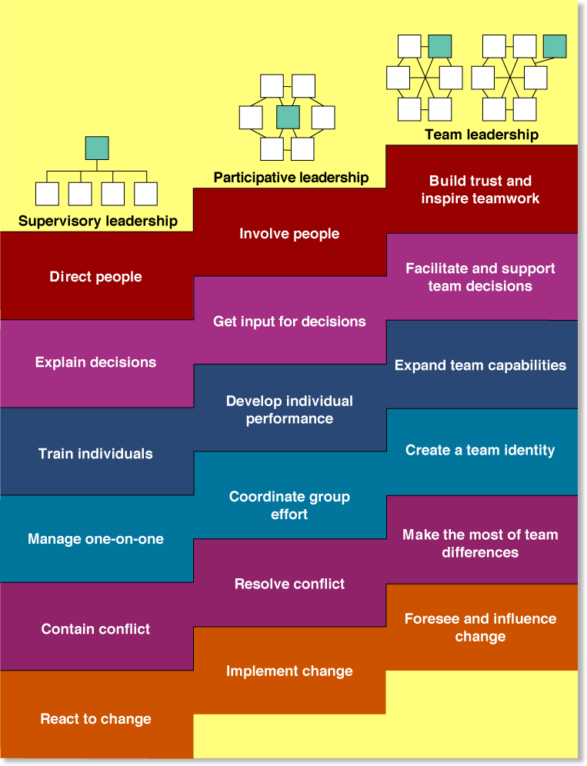
Stepping up to Team
Leadership
Figure 14.2
14-<number>

Slide 19
Building Effective Teams
Team effectiveness is defined by three criteria:
Productive output of the team meets or exceeds standards of quantity and quality
Team members realize satisfaction of their personal needs
Team members remain committed to working together again
14-<number>

Slide 20

Motivating Teamwork
Social loafing
  Working less hard and being less productive when in a group.
14-<number>

Slide 21
Motivating Teamwork
Social facilitation effect
  Working harder when in a group than when working alone.
14-<number>

Slide 22

Question
  ___________ are shared beliefs about how people should think and behave.
  Roles
  Norms
  Expectations
  Customs
14-<number>
Notes:
The correct answer is b - norms. See next slide.

Slide 23
Norms and Roles
Norms
  Shared beliefs about how people should think and behave.
Roles
  Different sets of expectations for how different individuals should behave.
14-<number>

Slide 24
Roles
Task specialist
  An individual who has more advanced job-related skills and abilities than other group members possess.
Team maintenance specialist
  Individual who develops and maintains team harmony.
14-<number>

Slide 25
Cohesiveness
Cohesiveness
  The degree to which a group is attractive to its members, members are motivated to remain in the group, and members influence one another.
14-<number>

Slide 26
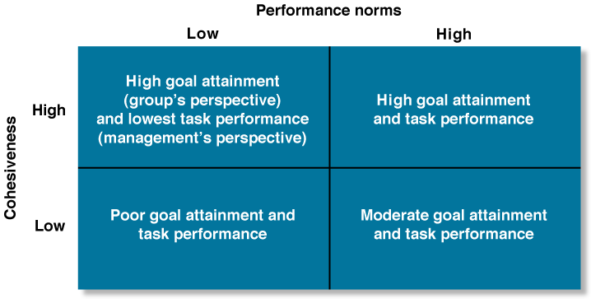
Cohesiveness, Performance Norms, and Group Performance
Figure 14.3
14-<number>

Slide 27
Building Cohesiveness and High-Performance Norms
Recruit members with similar attitudes, values, and backgrounds
Maintain high entrance and socialization standards
Keep the team small
Help the team succeed, and publicize its successes
Be a participative leader
Present a challenge from outside the team.
Tie rewards to team performance
14-<number>

Slide 28

Managing Outward
Gatekeeper
  A team member who keeps abreast of current developments and provides the team with relevant information.
14-<number>

Slide 29
Managing Outward
Informing
  A team strategy that entails making decisions with the team and then informing outsiders of its intentions.
Parading
  A team strategy that entails simultaneously emphasizing internal team building and achieving external visibility.
14-<number>

Slide 30

Managing Outward
Probing
  A team strategy that requires team members to interact frequently with outsiders, diagnose their needs, and experiment with solutions.
14-<number>

Slide 31
Lateral Role Relationships
Work-flow relationships
  emerge as materials are passed from one group to another
Service relationships
  exist when top management centralizes an activity to which a large number of other units must gain access
Advisory relationships
  created when teams with problems call on centralized sources of expert knowledge
14-<number>

Slide 32
Lateral Role Relationships (cont.)
Audit relationships
  develop when people not directly in the chain of command evaluate the methods and performances of other teams
Stabilization relationships
  involve auditing before the fact
Liaison relationships
  involve intermediaries between teams
14-<number>

Slide 33
Question
  Which style of conflict involves moderate attention to both parties’ concerns.
  Avoidance
  Accommodation
  Compromise
  Competing
  Collaboration
14-<number>
Notes:
The correct answer is c – compromise. See slide 14-33

Slide 34
Conflict Styles
Avoidance
  A reaction to conflict that involves ignoring the problem by doing nothing at all, or deemphasizing the disagreement.
Accommodation
  A style of dealing with conflict involving cooperation on behalf of the other party but not being assertive about one’s own interests.
14-<number>

Slide 35
Conflict Styles (cont.)
Compromise
  A style of dealing with conflict involving moderate attention to both parties’ concerns.
Competing
  A style of dealing with conflict involving strong focus on one’s own goals and little or no concern for the other person’s goals.
14-<number>

Slide 36
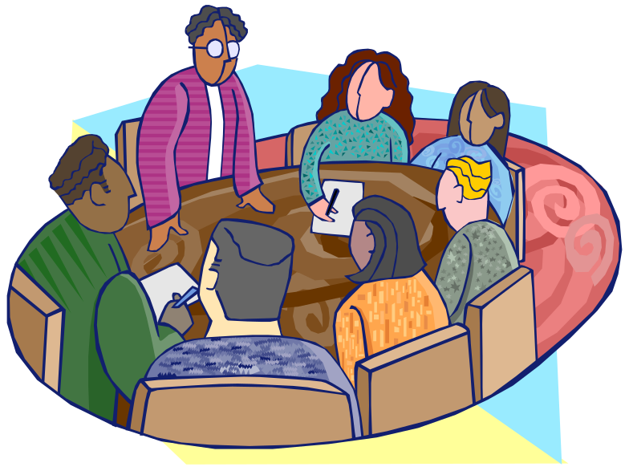
Conflict Styles (cont.)
Collaboration
  A style of dealing with conflict emphasizing both cooperation and assertiveness to maximize both parties’ satisfaction.
14-<number>

Slide 37
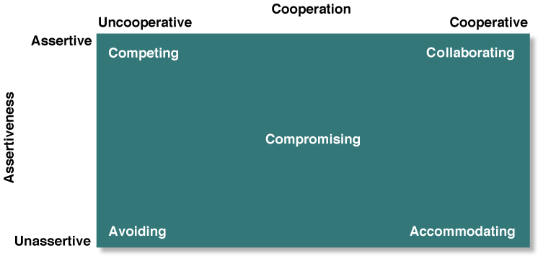
Conflict Management Strategies
Figure 14.4
14-<number>

Slide 38
Managing Conflict
Superordinate goals
  Higher-level goals taking priority over specific individual or group goals.
14-<number>

Slide 39

Being a Mediator
Mediator
  A third party who intervenes to help others manage their conflict.
14-<number>

Slide 40
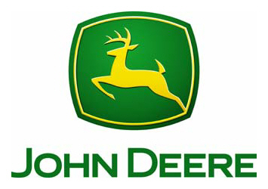
Destination CEO: John Deere
What conflict style did Bob Lane use when dealing with the union?
Provide examples of how Bob Lane has helped Deere regain profitability.
14-<number>
Notes:
BusinessWeek TV’s Destination CEO
Name: Deere & Co.
CEO of Company: Bob Lane
Themes: innovation, technology
Suggested chapters: 17
Short paragraph about the video.
You may recognize their bright green products with the distinctive yellow deer. Deere & Co. is the world’s leading provider of agricultural, forestry, construction, and lawn products and services. Founded in 1837, Moline, Illinois-based Deere has come a long way since its early days of building the first steel plow. Today it is a complex and flexible organization today producing top-of-the line combines with over 17,000 individual parts and costing over $250,000.
Bob Lane started his career as a banker for Deere. Since 2000 Lane has served as Deere’s CEO, through both good times and bad. He is only the third CEO who isn’t from the original family. During a recent slump at Deere, Lane worked with the United Auto Workers (UAW) to cut costs, inventory, and jobs. He admits that Deere’s good labor-management relations may strain if health care benefits are reduced when the current UAW contract expires in 2009.
Deere trades under the symbol DE on the NYSE.
3-4 multiple choice questions with answers regarding video topics
Before becoming Deere’s CEO, Lane had a career in what field?
teaching
banking
law
medicine
John Deere products are famous for what logo?
dog
lightening bolt
deer
triangle
Which union represents Deere employees?
UAW
AFL-CIO
SEIU
International Brotherhood of Teamsters
2-3 essay or discussion questions with suggested answers regarding video topics
Provide examples of how Bob Lane has helped Deere regain profitability.
Lane worked with the United Auto Workers (UAW) when it became necessary to cut costs, inventory, and jobs. He moved some work out of non-UAW shops and brought them into newly re-tooled UAW sites.
Conduct some research at the John Deere web site on Deere’s M-Gator and R-Gator vehicles. Explain the technological features of these products.
Students’ responses will vary. Both the M-Gator and R-Gator are highly technological military utility vehicles. The M-Gator is frequently used for search-and-rescue missions, while the R-Gator is a fully autonomous unmanned ground vehicle.

